Slide 1
A Study on Asymmetric Space Weathering with an Updated Lunar Crater List
Kilho Baek¹, Sungsoo S. Kim¹, Chae Kyung Sim²
¹Kyung Hee University
²Korea Astronomy and Space Science Institute

Slide 2
Research about the Moon
Geology
(Inside & On)
Astronomy
(Outside & Onto)
Ground-based
(Near-side)
the body
Formation & Evolution
Internal Structure
Activity (volcanism, tectonics)
Geographical Features
Composition
the regolith
Gardening & Weathering
External Environment
Space-weathering
(solar-wind, meteorites, cosmic-ray)
Overall Surface
Maturation
Lander & Rover
(In-situ, Sample return)
Lunar Orbiter
(Global Map)

Slide 3
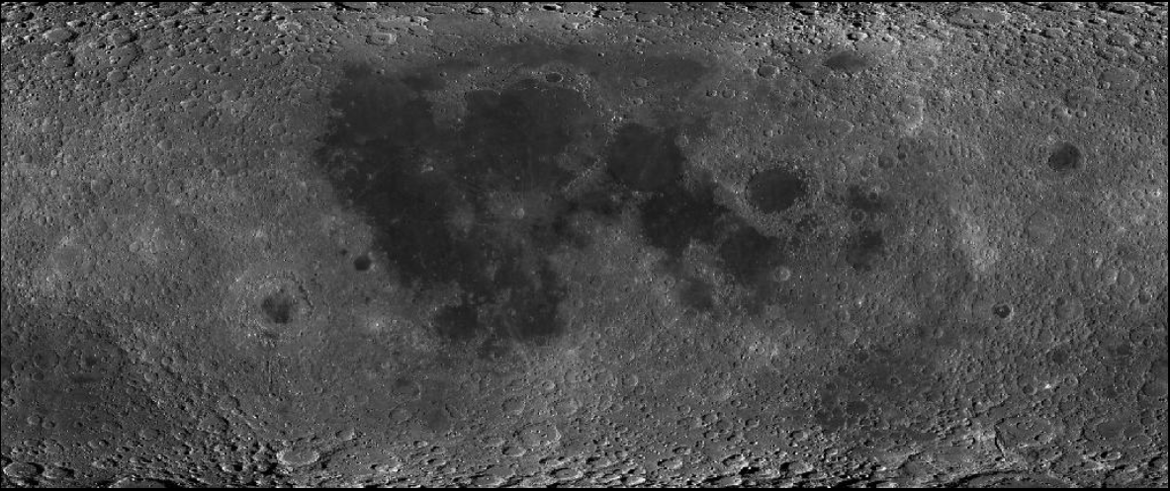
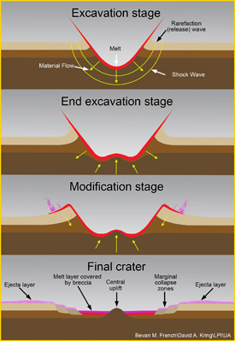
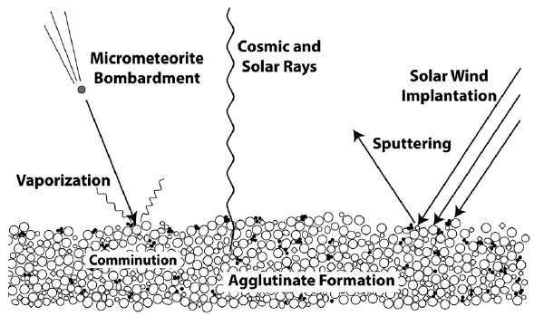
Astronomical Perspective
Pieters & Noble (2016) JGRE
Giordano Bruno (4 Myr)
Maria : ~3.8 Gyr
Copernicus (800 Myr)
Highlands : ~4.6 Gyr
Tycho (108 Myr)
Fresh Regolith
(resurfacing)
Space Weathering
Optical & Physical
properties

Slide 4
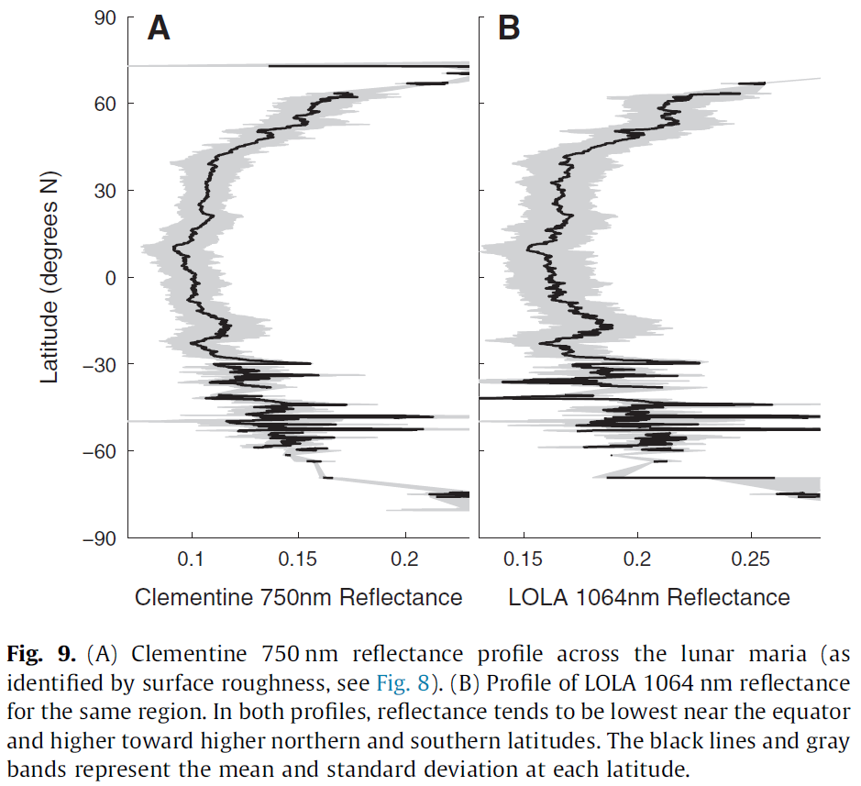
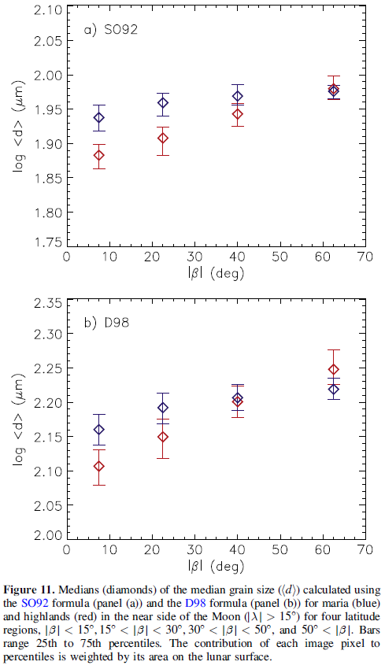
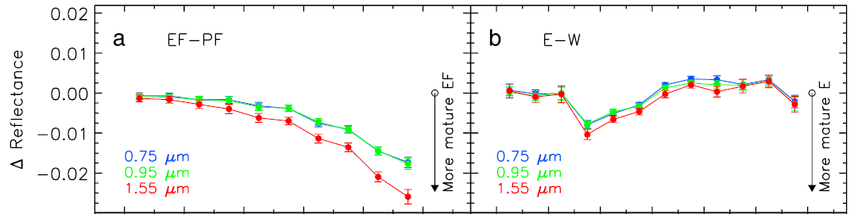
Recent Studies
① Jeong et al. (2015)
② Hemingway et al. (2015)
③ Sim et al. (2017)
By micro-meteorites
By solar-wind particles
By solar-wind particles
[ only near-side, with polarization ]
[ only maria, with swirl ]
[ whole moon, with crater wall ]
Latitude ↑
ΔReflectance ↓
Grain Size ↑
Reflectance ↑
Lat.
Stronger
Flux
Latitude ↑
Latitude ↑
Lower latitude ➔ Stronger Flux ➔ More Mature
ΔReflectance ↓
① Smaller Grain size
② Darker Reflectance, Redder Color
③ Lower ΔRefelctance, ΔOMAT
Longitude

Slide 5
Database & Global Map
 | Lunar Impact Crater Database (LPI 2015) | Moon Crater Database (Robbins et al., 2018)
Total Number | 8716 | ~1.3 million
Main Information | Latitude & Longitude
 | Diameter | Major/Minor-axis
 | Topography | Photometry
Data | Digital Elevation Map (DEM) | Reflectance (415 ~ 1550 nm)
Instrument | LOLA + SELENE Terrain Camera (Lunar Orbiter Laser Altimeter) | MI (Multi-band Imager)
Spacecraft | LRO (Lunar Reconnaissance Orbiter) | SELENE (Selenographical and Engineering Explorer)
Latitude | -60° ~ +60°
Resolution | 512 ppd (≈ 60 m/pixel)
Why craters?
The wall quadrants had been exposed on the surface
for the same duration after the crater was formed.
Why wall-quadrants?
The opposite walls have different incident angles of the space weathering particles, then they experience different flux after exposure to the surface.
Approximately complete for all craters
larger than about 1-2 km in diameter.

Slide 6
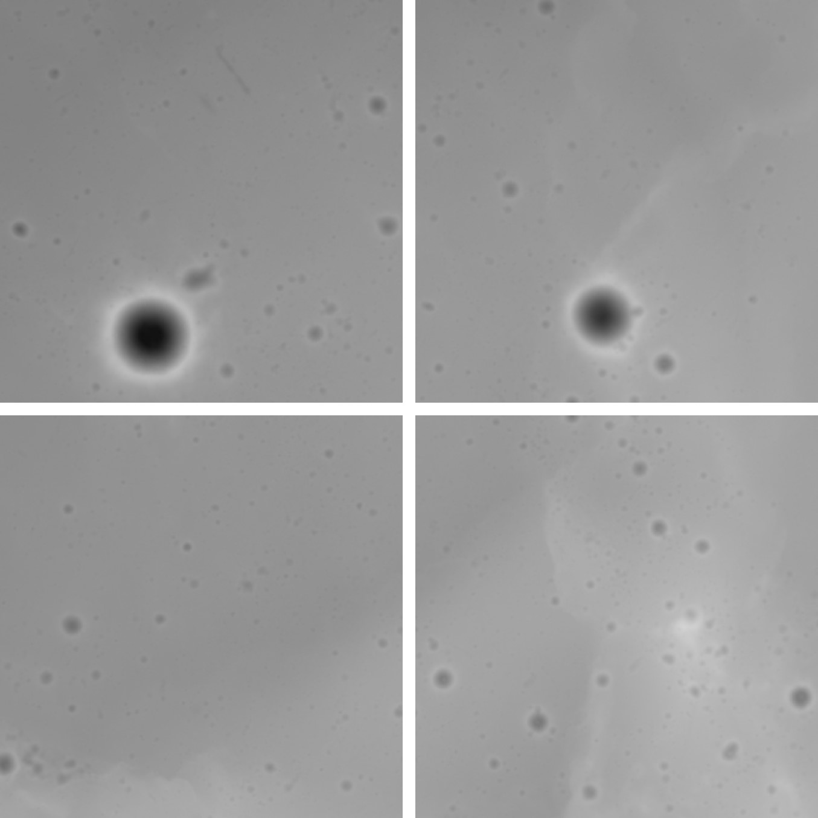
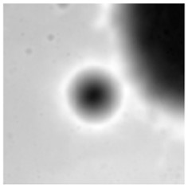
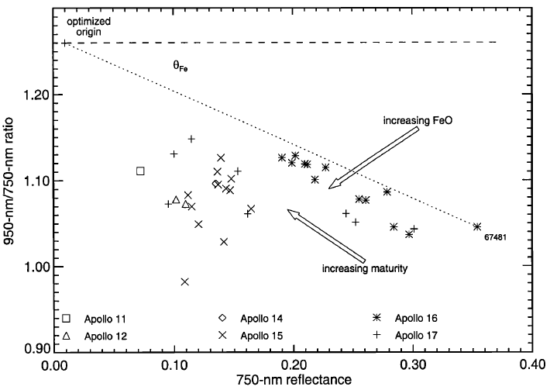
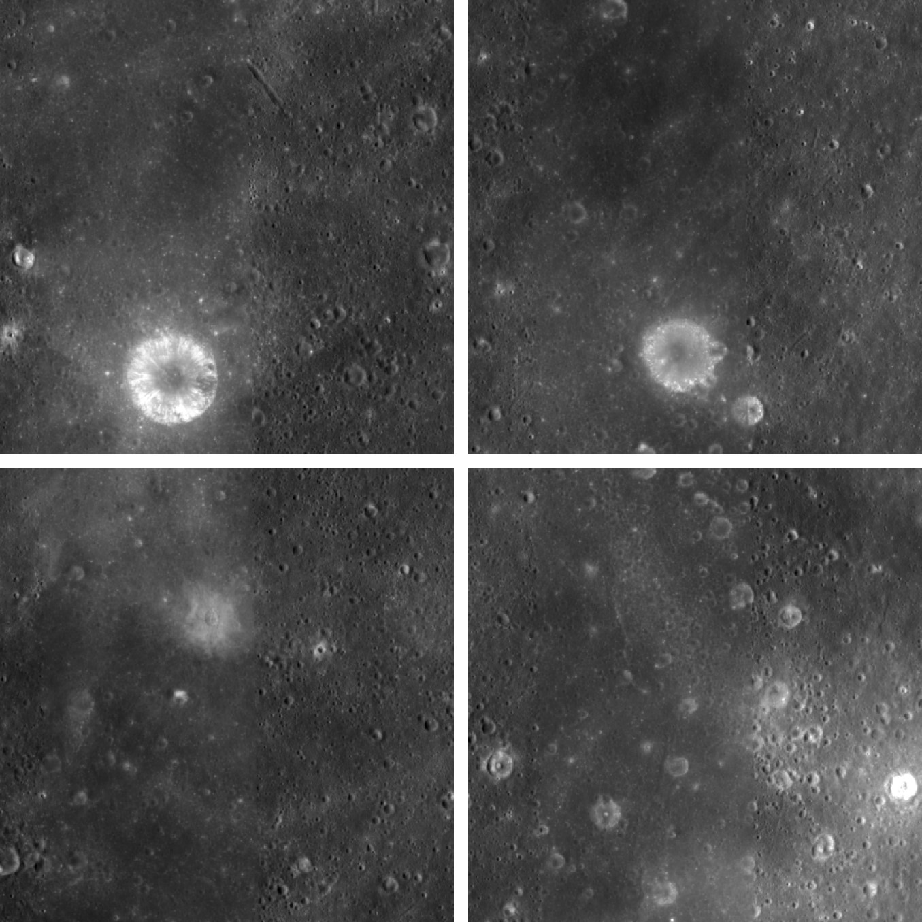
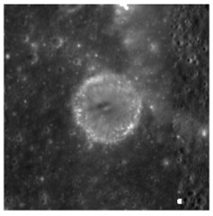
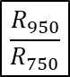

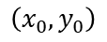


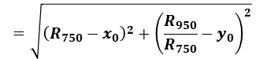


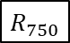
Craters & Properties
Global Mosaic
Elevation
Morphological Properties
reflectance : $R_{750}$, $R_{950}$
DEM
slope
azimuth angle
diameter
(major/minor axis)
optical maturity : $OMAT$
Topography
Hyper-mature
Lucey et al. (2000)
$$\left(x_{0}, y_{0}\right)$$
$$=\sqrt{{\left(R_{750}−x_{0}\right)}^{2}+{\left(\frac{R_{950}}{R_{750}}−y_{0}\right)}^{2}}$$
$$OMAT$$
Global Mosaic
Multi-band Images
(9 bands)
Optical Properties
$$\frac{R_{950}}{R_{750}}$$
reflectance
reflectance ratio
reddening
0.95 m depth
optical maturity (OMAT)
Photometry
$$R_{750}$$
The smaller $OMAT$, the more mature.

Slide 7
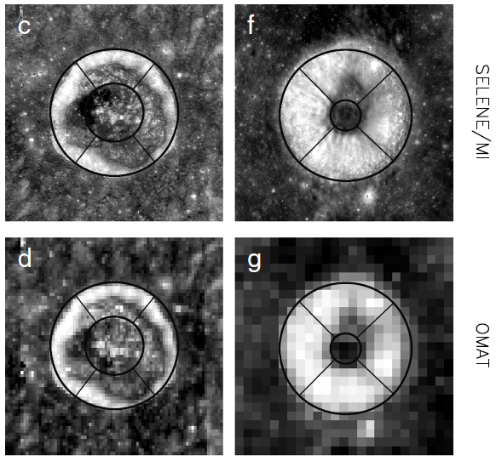
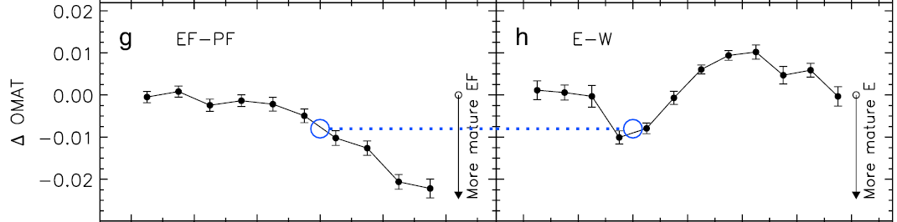
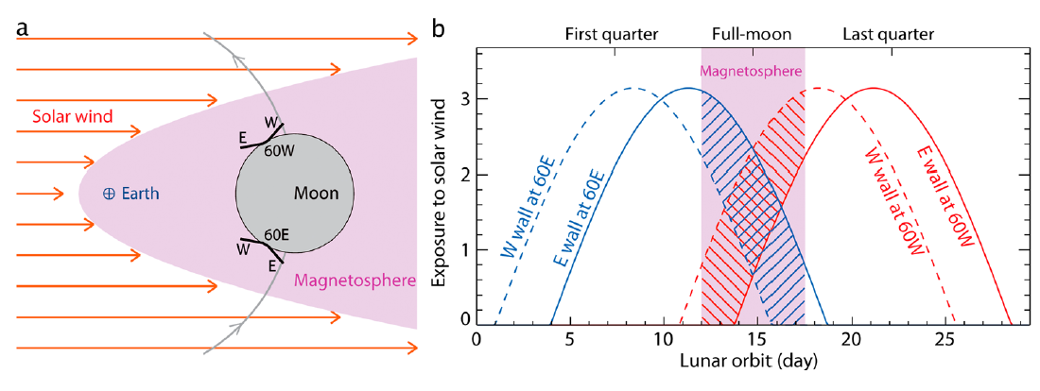
Analysis using crater wall-quadrants
Sim et al. (2017)
DARKER Reflectance
MORE Mature
North
STRONGER
Flux
Equator
Facing
North
Pole
West
Eest
solar wind
South
Pole
Facing
Equator
Lat.
Pole
Facing
Equator Facing
South
Pole

Slide 8
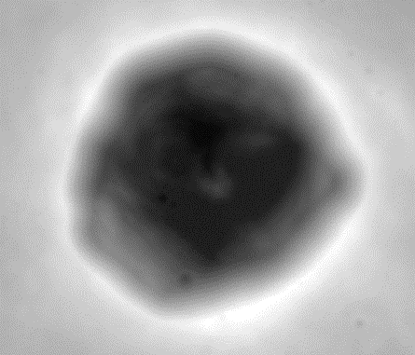
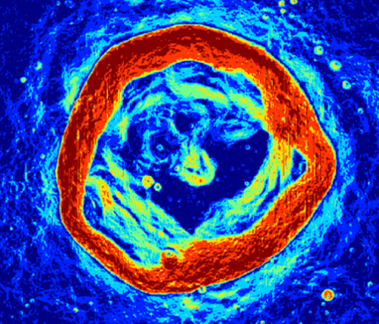
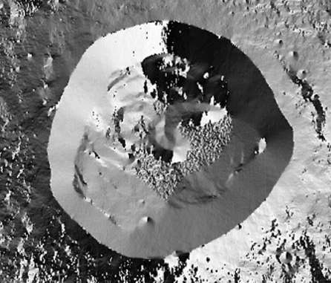
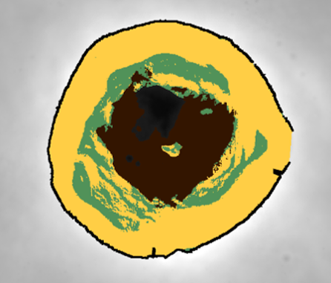
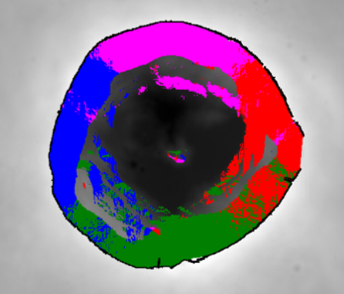
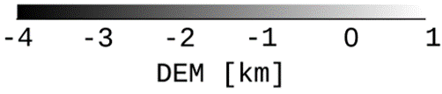
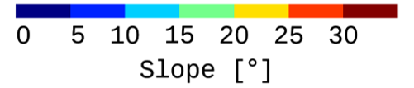
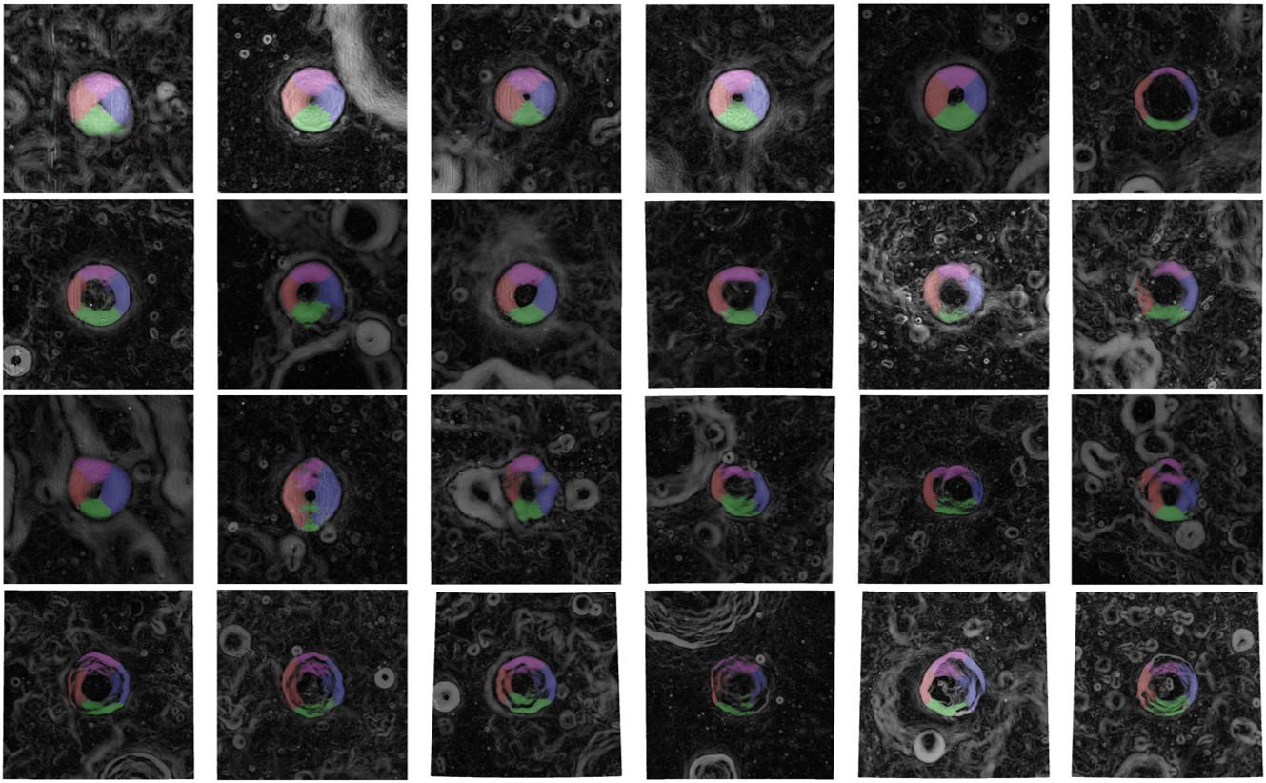
Algorithms to define crater features
DEM [km]
Slope [°]
Azimuth Angle [°]
Inner Structures
Wall-Quadrants
rim
3D vector
calculation
DEM
Slope
Azimuth
-4
-2
0
0
10
20
30
-180
0
180
Floor
Terrace
wall
E
N
S
W
Simple
Complex

Slide 9
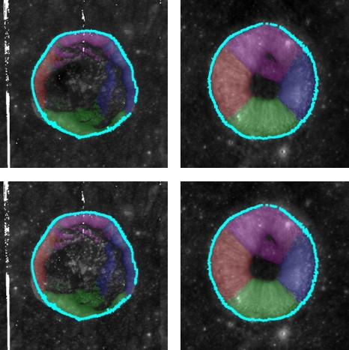
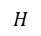
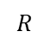
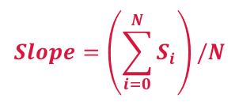
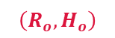
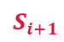
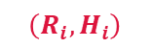

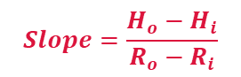
Comparison with the previous study
Sim et al. (2017)
This study
Slope between two points
Mean of slopes of all pixels on the wall
$$H$$
$$\left(R_{o}, H_{o}\right)$$
$$Slope=\left(\sum_{i=0}^{N}{S_{i}}\right)/N$$
$$Slope=\frac{H_{o}−H_{i}}{R_{o}−R_{i}}$$
$$S_{i+1}$$
$$\left(R_{i}, H_{i}\right)$$
$$S_{i}$$
$$R$$

Slide 10
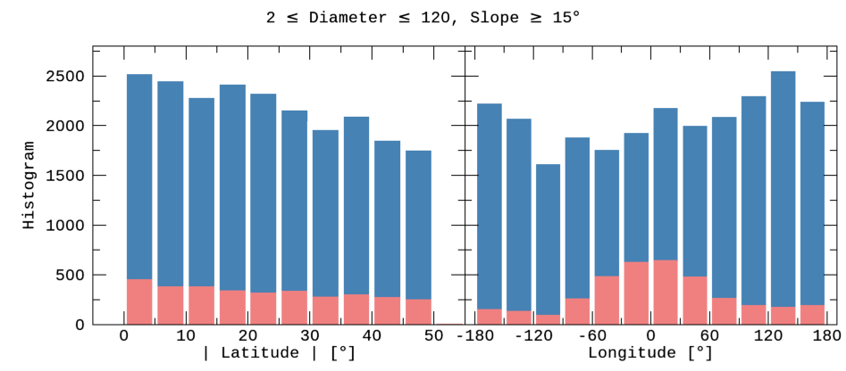
Improvements
 | Sim et al. (2017) | This study
Database | LPI (2015) |  | Robbins et al. (2018)
Samples | 1,872 | 3,144 | 26,802
Resolution | 1 km/pixel | 60 m/pixel
Diameter | 5 ~ 120 km |  | 2 ~ 150 km
2018
DB
2015
DB

Slide 11
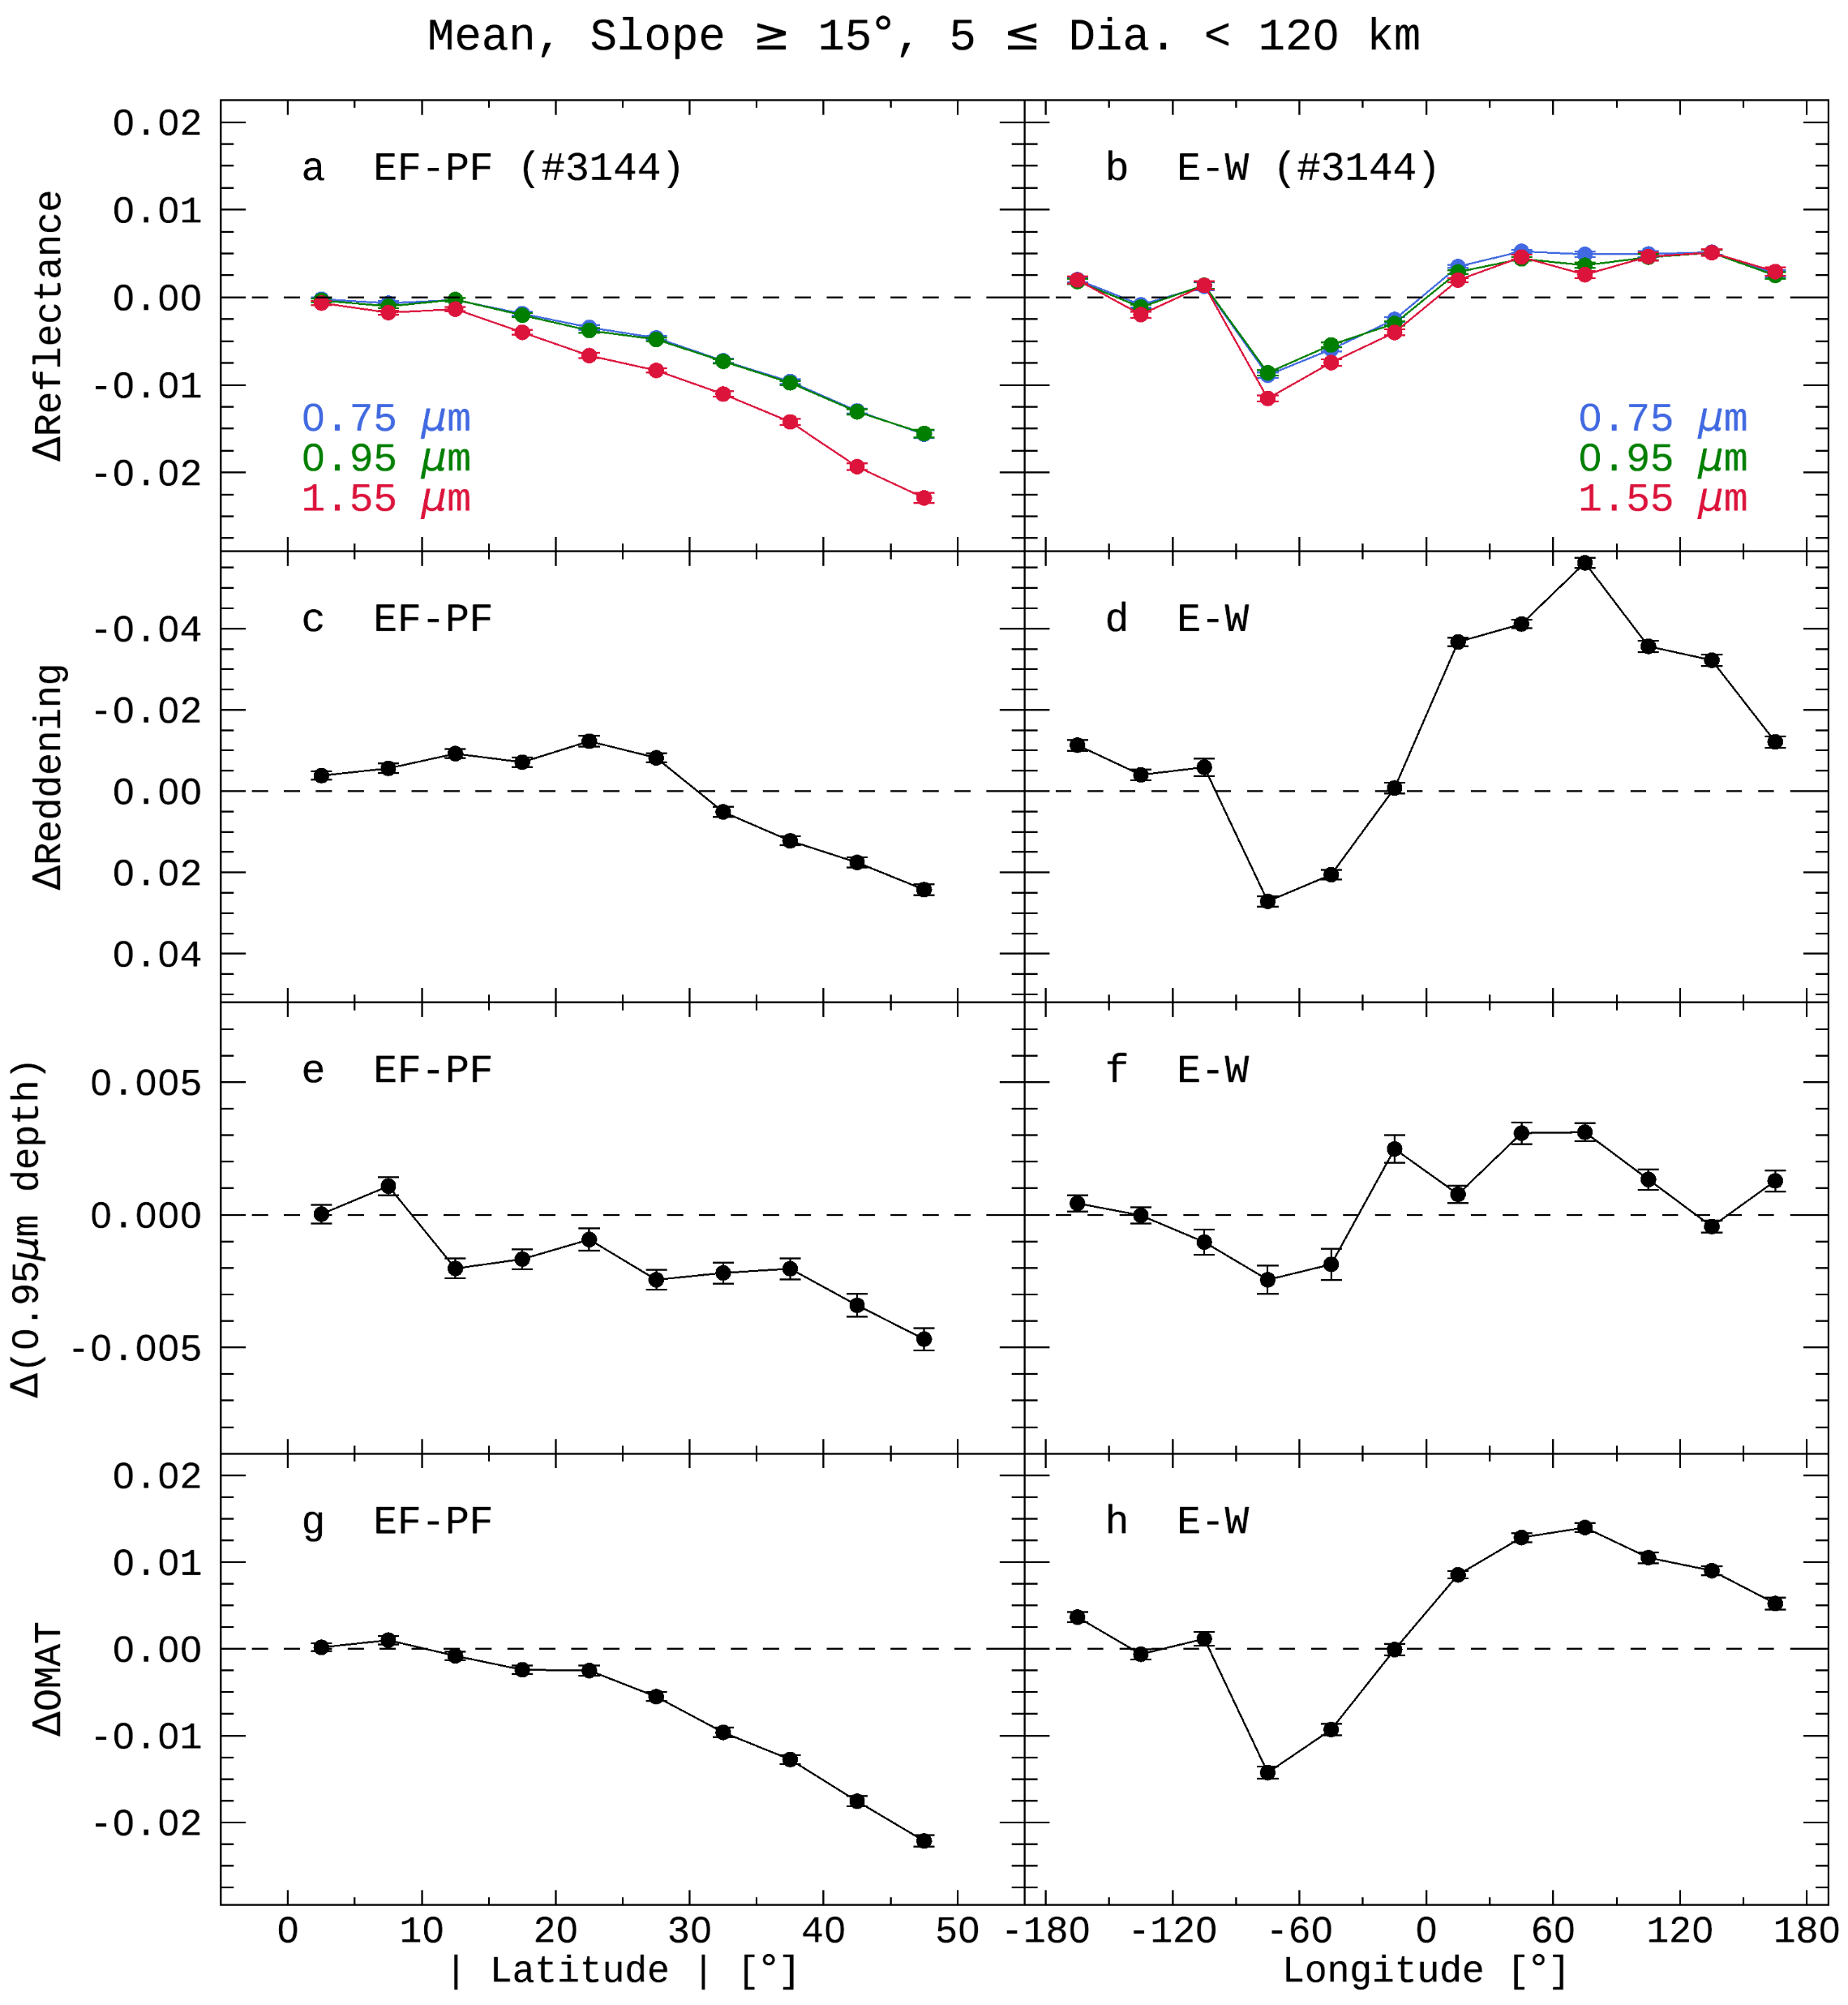
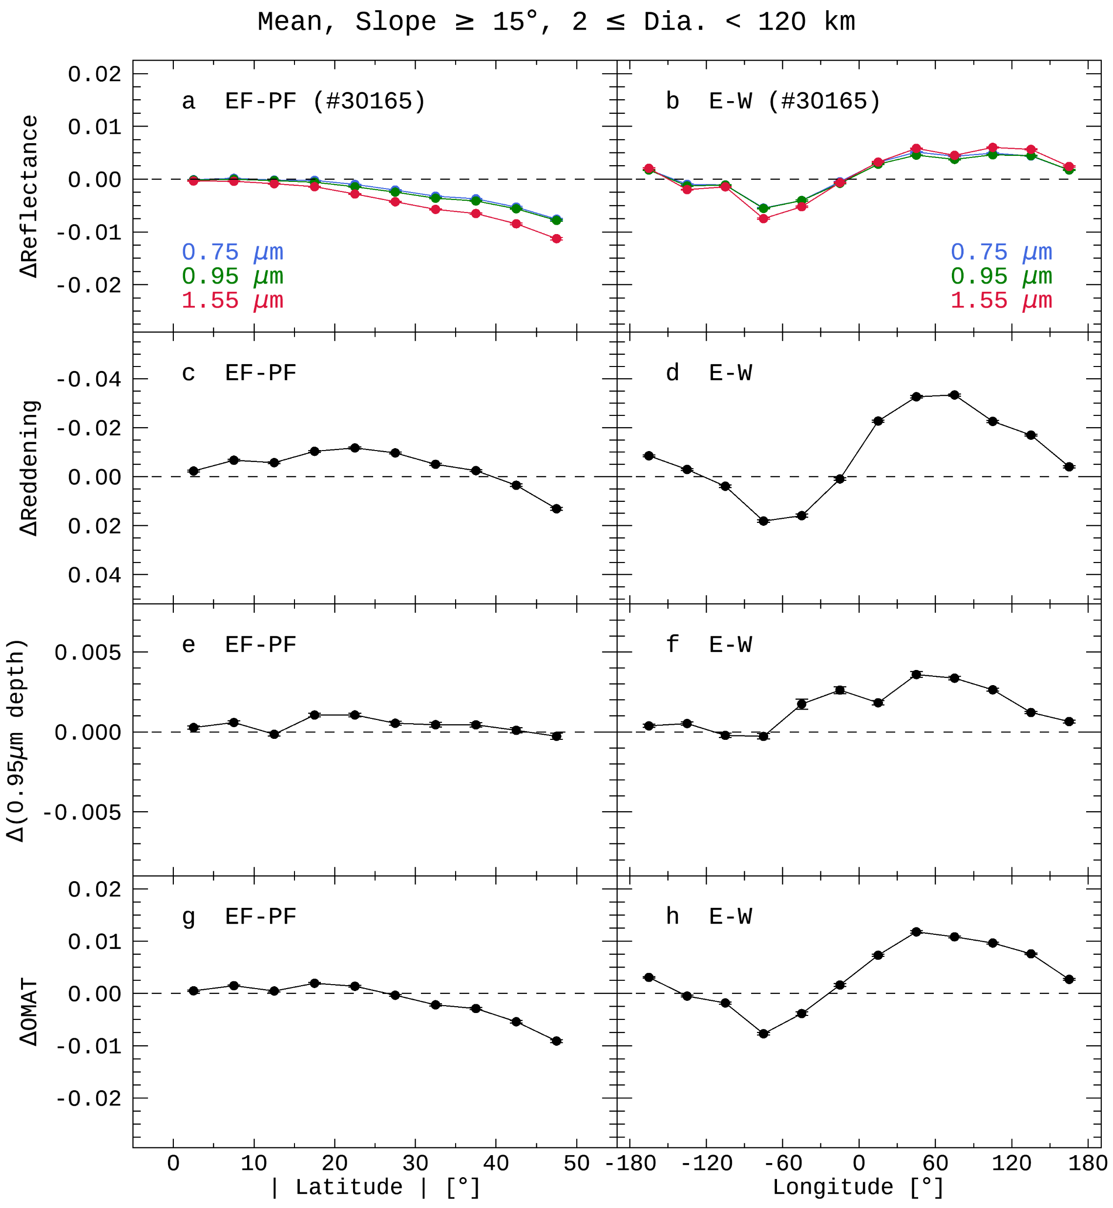
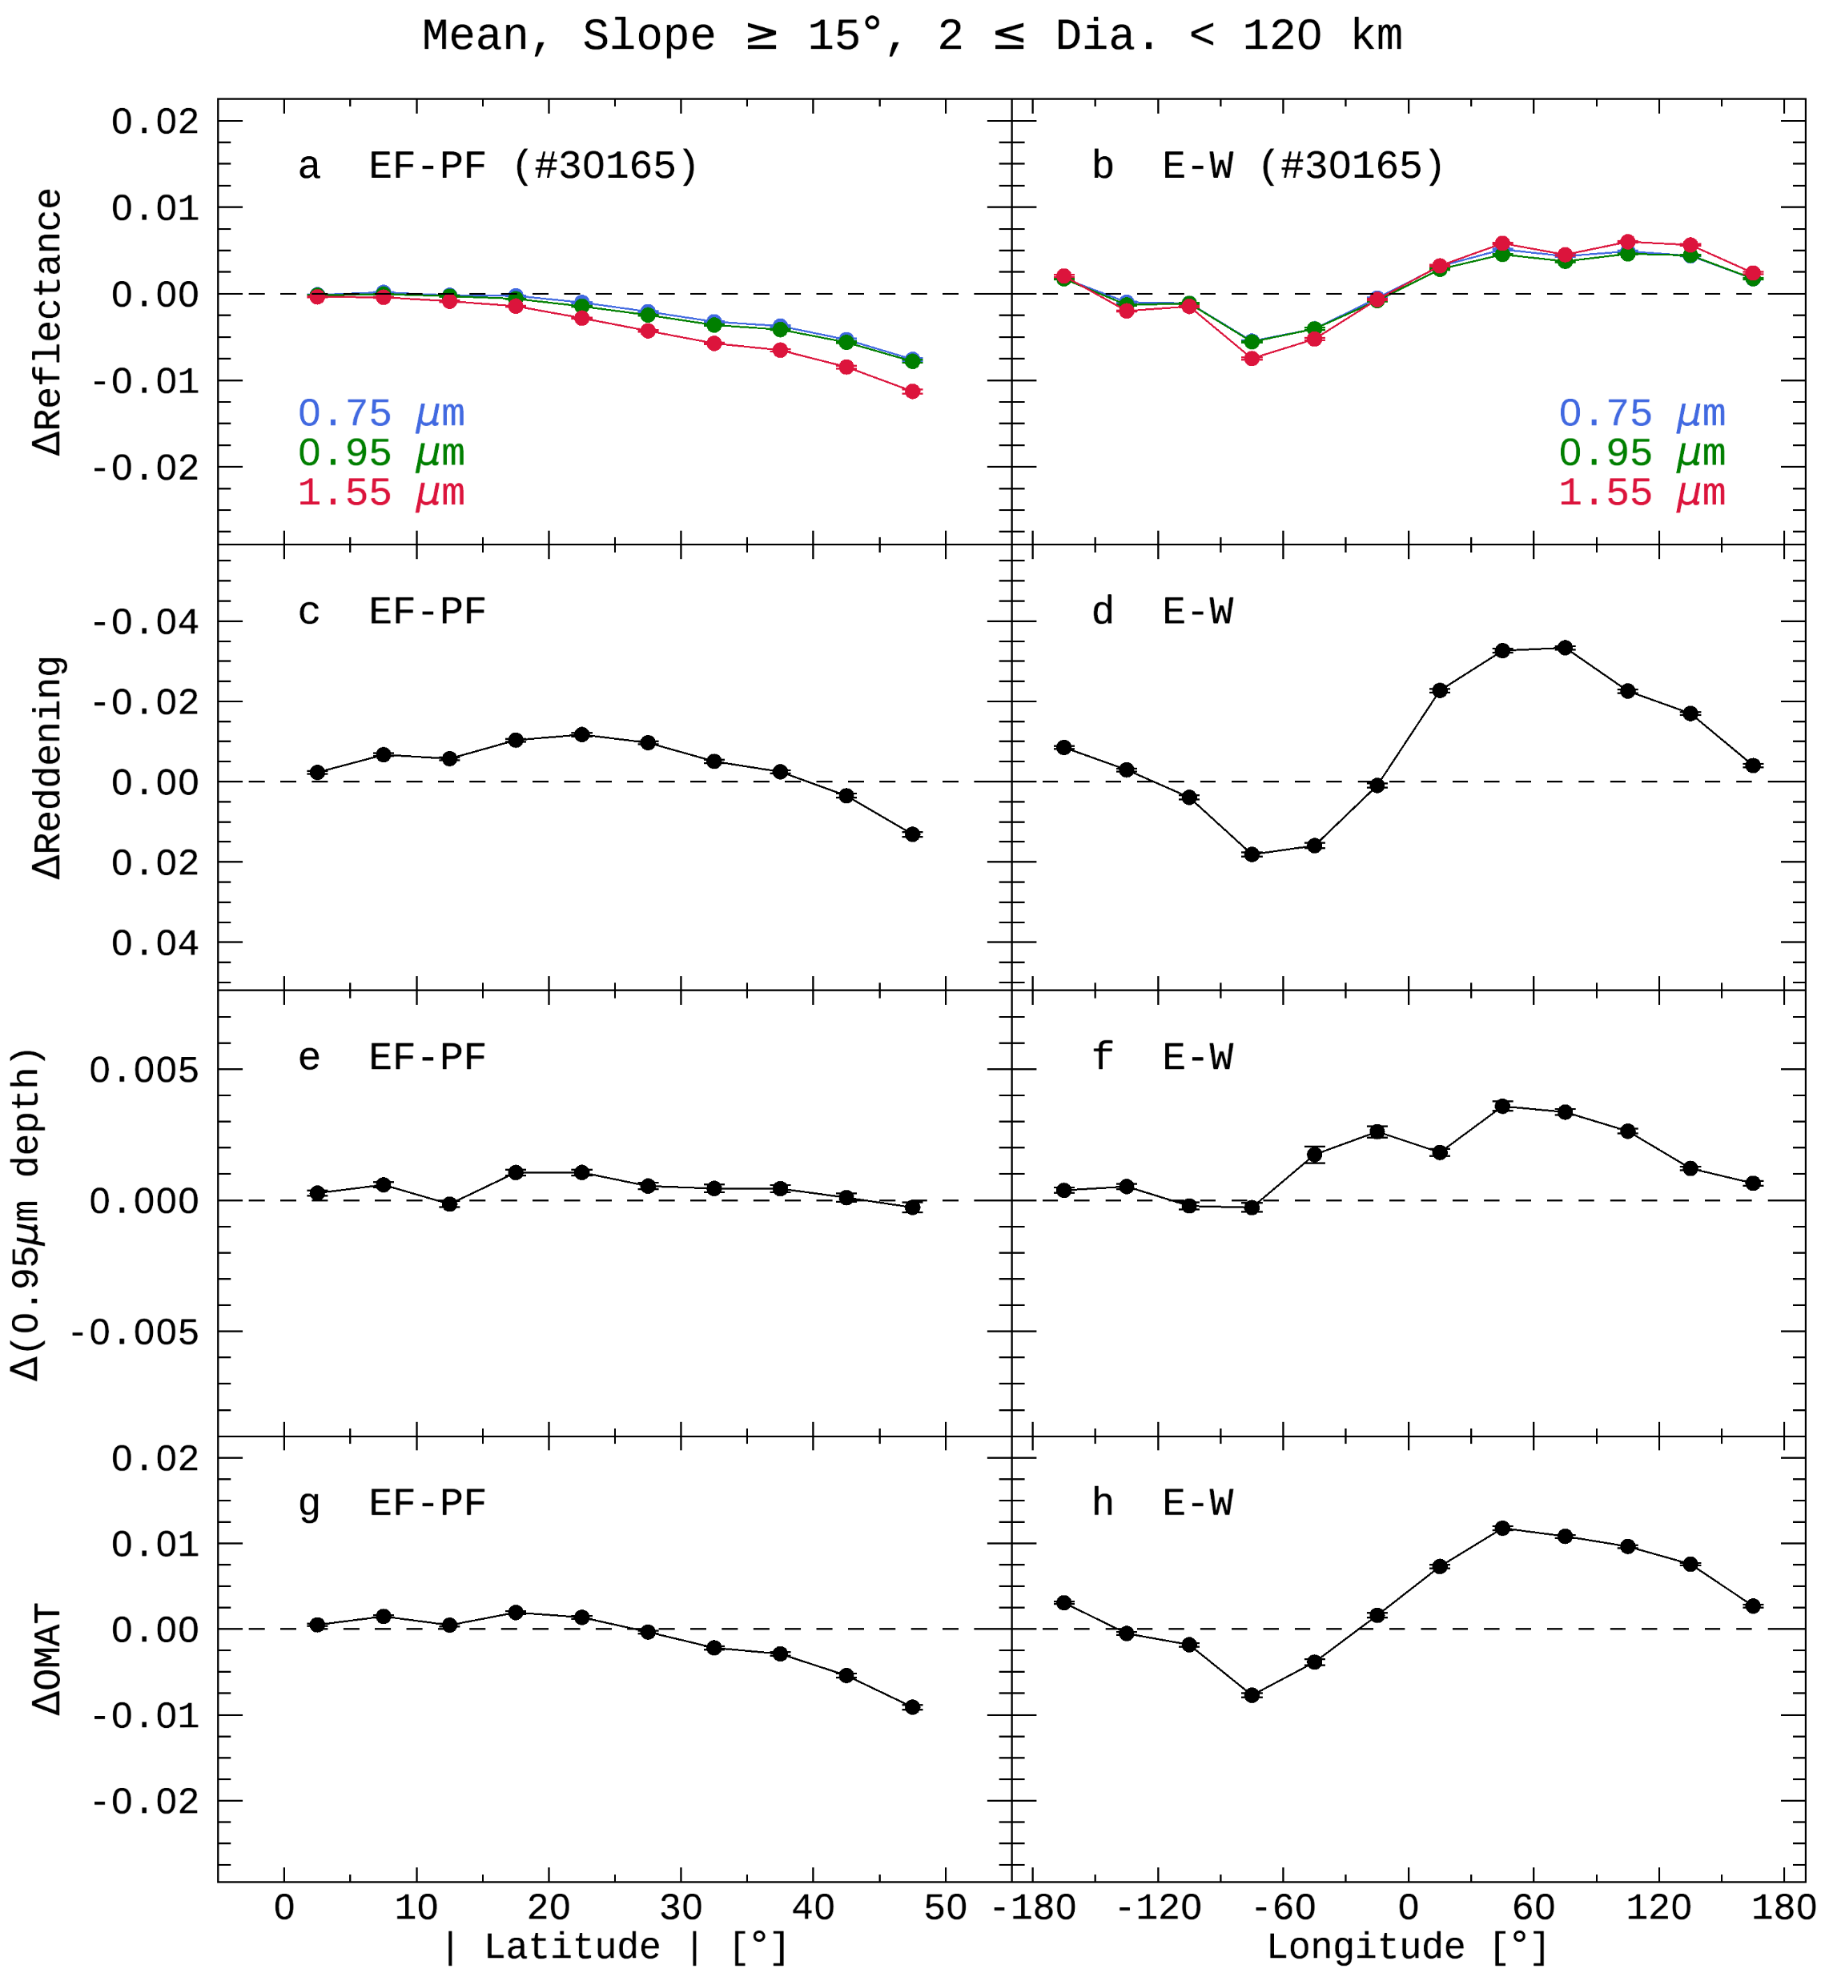
Reproduction
Sim et al. (2017) : 2015 DB
This study : 2015 DB + improved methods
This study : 2018 DB + improved methods
Both databases show
extremely similar results!

Slide 12
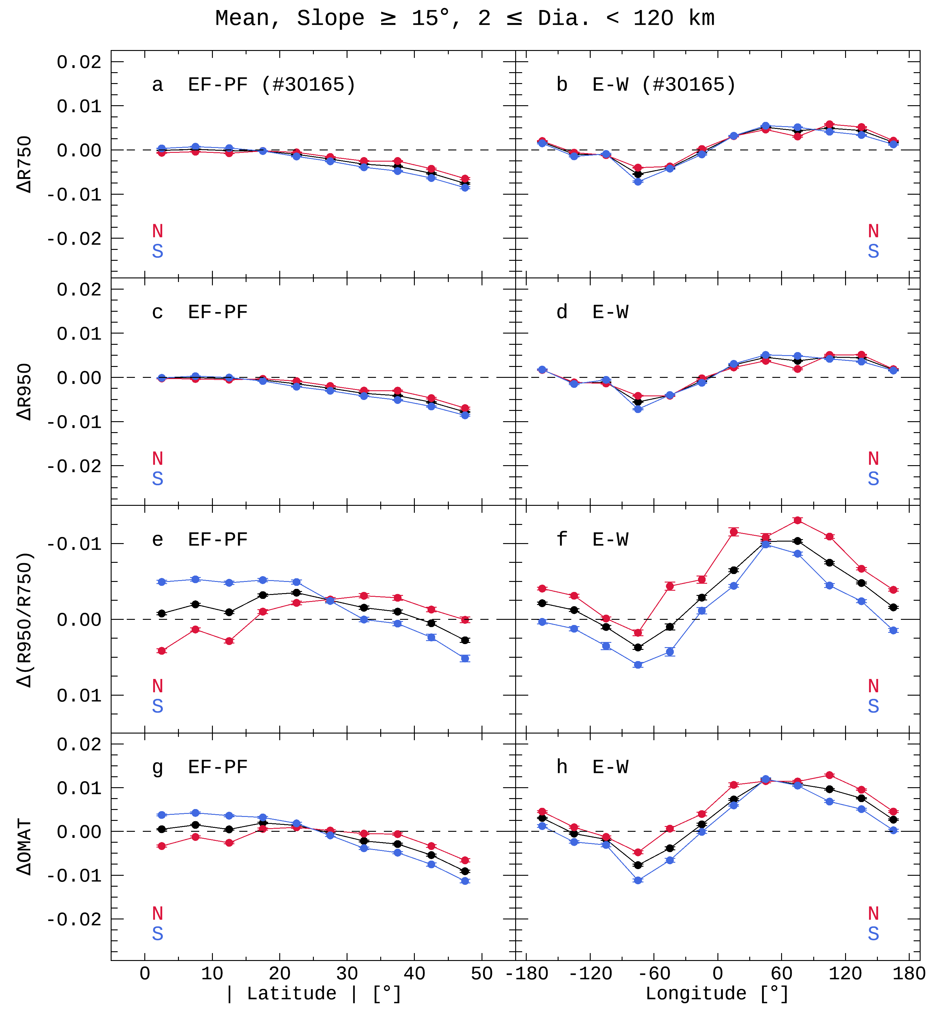
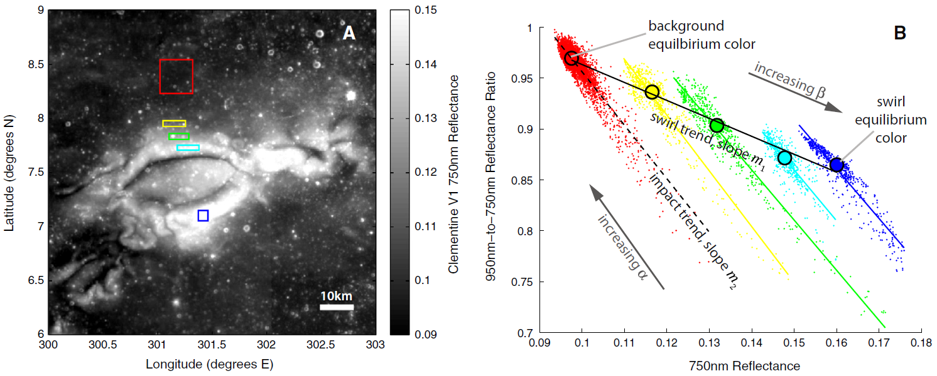
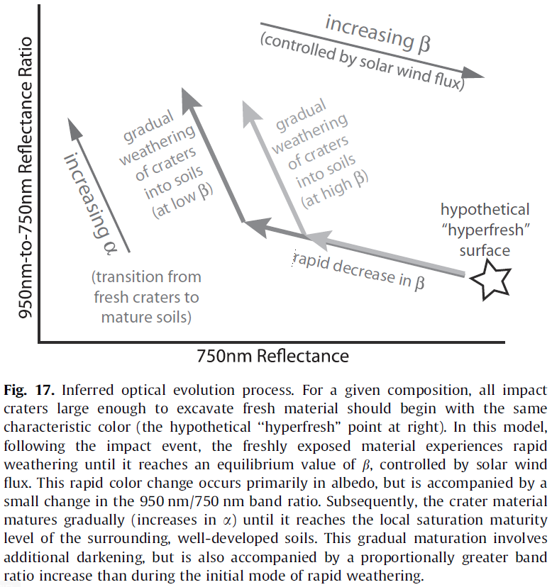
Detailed Analysis
Hemingway et al. (2015)
STRONGER
Flux
North
Pole
EF wall
solar wind
PF wall
Same Flux
Lat.
Equator
PF wall
Asymmetric impact flux
of (micro-)meteorites or secondary particles (ejecta)
EF wall
South
Pole

Slide 13
Summary & Future Work
Improvements : Updated lunar crater list & Algorithms to define realistic crater features (Ensure statistical significance by reproducing the previous study)
Findings : Latitudinal asymmetry between northern and southern hemispheres Findings : Longitudinal color offset on northern hemisphere
Causes : Asymmetric impact flux of (micro-)meteorites or secondary particles (ejecta)
It is expected that grain size distribution obtained by PolCam on ‘Danuri’ will provide clues to interpret the physical alteration.
 | Compositional or Physical Alteration | Optically
Solar wind particles | nano-phase iron | Mature
Micrometeorites | nano- & micro-phase iron
 | Comminution (grain size become smaller) | Fresh (physically mature)
Meteorites | Excavation or Gardening (fresh soils come up to the surface) | Fresh

Slide 14
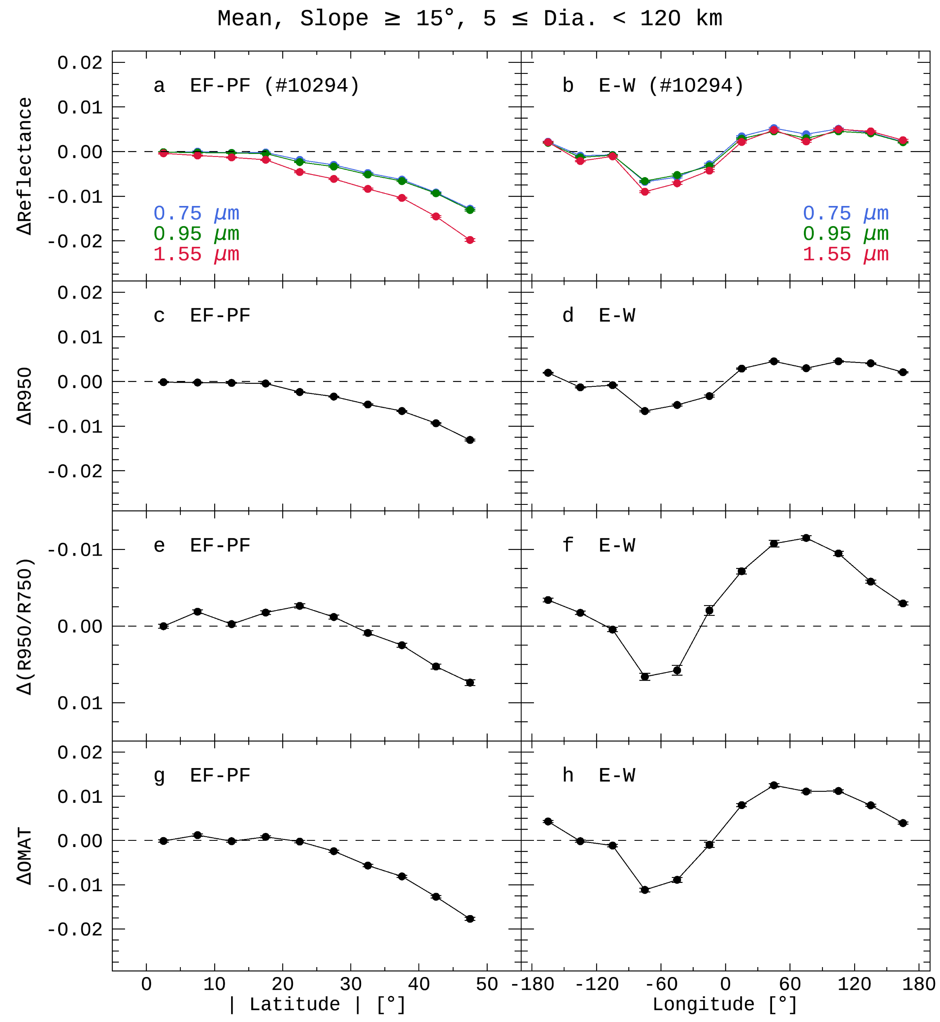
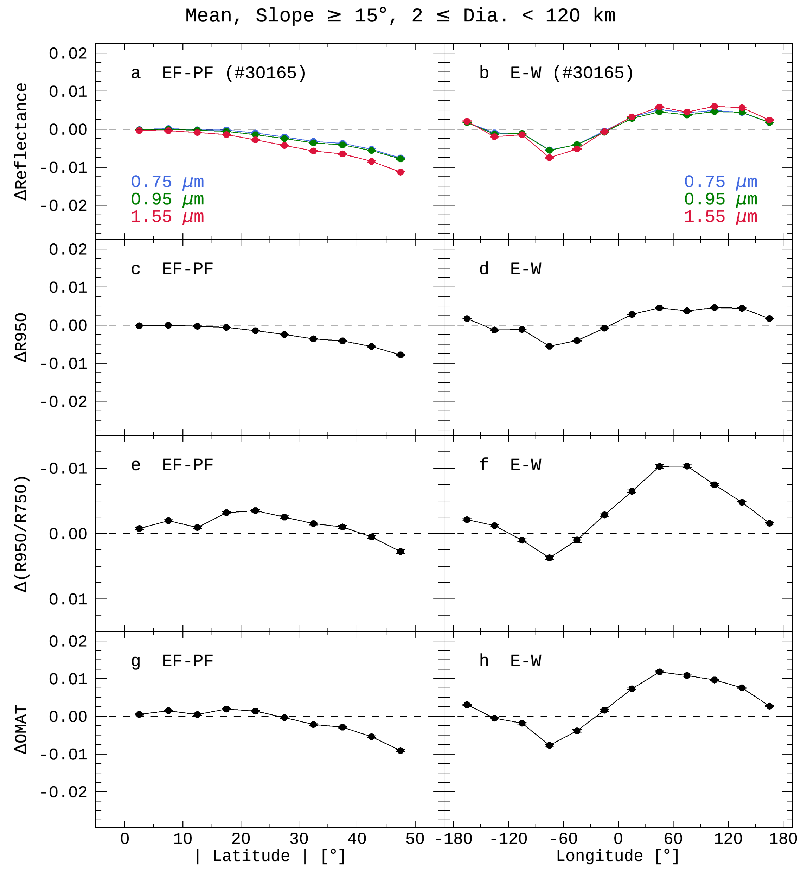
Supplements

Slide 15
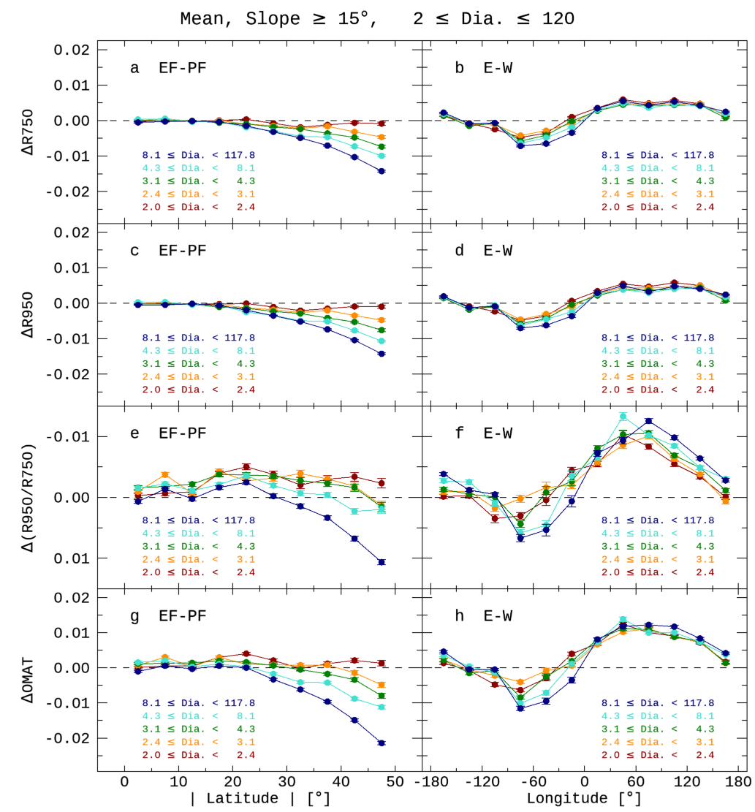
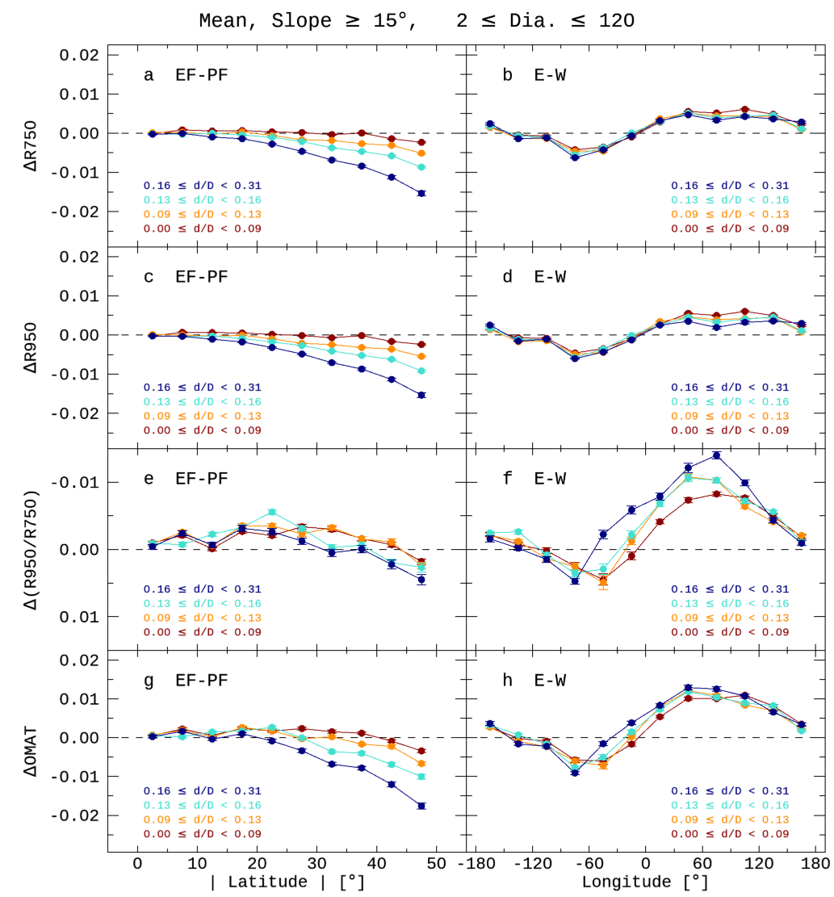
Supplements

